Slide 1





Genome Pods
for
Clinical Practice
Elias Crum
vito.be

Slide 2






Outline
Genomic Data in Health Care?
Why?
Genomic Data in Solid Pods?
How Solid is helpful
What?
Example clinical workflow introduction
How?
“Demo” workflow of Genome Pods UI
vito.be

Slide 3





Genome Data
Genome data is big...
Ghent Belfry
~130m
~91m
Other considerations
Storage
Privacy
Governance
Printed
Human Genome¹
Formatting
vito.be

Slide 4
Genome Data: One Challenge “Solved”
Genome data is big...
Ghent Belfry
Variant Call Format (VCF) file
~130m
Individual humans exhibit ~3 million mutations (~125 MBs)
VCF file records only those differences
~91m
Printed
Human Genome¹
Other considerations: ??
vito.be

Slide 5








Genome Data in Health Care
Institution-centric
Data Storage
Technological
Infrastructure
?
&
Cloud
On-site
Data Usage
vito.be
Notes:
Tec

Slide 6



Scaling Genome Data Usage
Research genomic data sharing initiatives:
State-of-the-art for clinical genomic data sharing?
GDPR (EU) / HIPPA (US) *EU Health Data Spaces*
Not much...
vito.be

Slide 7






A Hybrid Solid Solution
Institution
Technological
Infrastructure
Data Storage
Data Usage
(Architecture #2)
vito.be

Slide 8
Solid Technology
Does not solve ALL problems, but offers an environment where improvements are possible
Easier sharing (web-facilitated)
Granular privacy controls
Direct patient data access
Data representation flexibility (RDF)
Possibility of data-linking and querying
vito.be

Slide 9
Disclaimer & Project Goals
The Genome Pods project is a RESEARCH project
It aims to develop a proof-of-concept
Framework and Web Application for:
Genomic data storage in Solid Pods
Granular privacy controls of genomic data
Genomic data representation in RDF
Data-linking potential
Data querying potential (within and across pods)
vito.be

Slide 10
Clinical Example
A patient is hospitalized with DVT
The physician makes the test results visible to the patient’s primary care physician
(out of network)
(DVT usually merits the perscription of Warfarin²)
The physician has just received a pharmacogenomic screening
(produced with the patient’s VCF file)
The physician queries his other patients for similar tests
(for additional dosing precedent)
The physician uploads the test results to the patient’s Genome Pod
vito.be

Slide 11
Example Workflow: Physician
Provider Login
App Landing Page
View Patient Data
Add test result to Patient pod
Query for other patient test results
Give read permission to another provider
vito.be

Slide 12
Figma example for workflow
Open Here
vito.be

Slide 13





Future Directions
Basic Functionalities:
Genomic data storage in Solid pods
Data privacy management
Data Sharing via the web
Experimental research:
Represent genomic data as RDF?
Linking genomic and health data?
Single and Many pod Querying?
vito.be

Slide 14



Thank you for listening!
Questions?
Part of the PErsoNal Genome QUery IN clinical practice (PENGQUIN) Ph.D. Project
vito.be
Funding provided by VITO NV (UG_PhD_2303_contract)

Slide 15
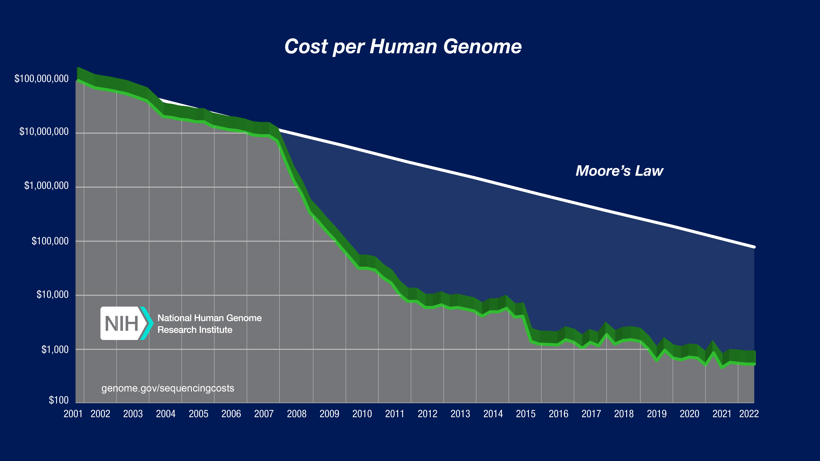
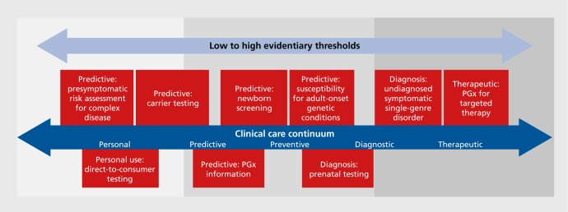
Genome Sequencing in Health Care
Sequence Generation Costs
Use-cases
10.31887/DCNS.2016.18.3/jkrier
Wetterstrand KA. Accessed 12/04/24.
Examples include:
Medication prescription (pharmacogenomics)
Genetic disease screening
Cancer diagnosis & treatment
Currently getting close to $100 per genome⁴
vito.be

Slide 16

Genome Data in Health Care
Data Storage
X
Technological
Infrastructure
&
Cloud
On-site
Data Usage
vito.be
Notes:
Tec

Slide 17


Implementation Specifics
Solid pod instances
Community Solid Server³
Genomic Data
Publicly available VCF data⁴
RDF Conversion
Aim to use SPHN RDF vocabulary⁵
Data-linking
Actively exploring ontologies / methodologies
Data Querying
Custom instance of Comunica⁶
vito.be

Slide 18
Sources
https://bio4.us/biotrends/human_genome_height.html
Tse, G. et al. Genotype‐guided warfarin dosing vs. conventional dosing strategies: a systematic review and meta‐analysis of randomized controlled trials. 2018. https://doi.org/10.1111%2Fbcp.13621
Wetterstrand KA. DNA Sequencing Costs: Data from the NHGRI Genome Sequencing Program (GSP) www.genome.gov/sequencingcostsdata. Accessed 12/04/24.
https://www.ultimagenomics.com/publications-and-resources?filter=Literature
vito.be

Slide 19




G
P

Slide 20
G
ENOME
P
ods

Slide 21







